Slide 1

InteractioNs in communities
By: Winter Hamilton

Slide 2
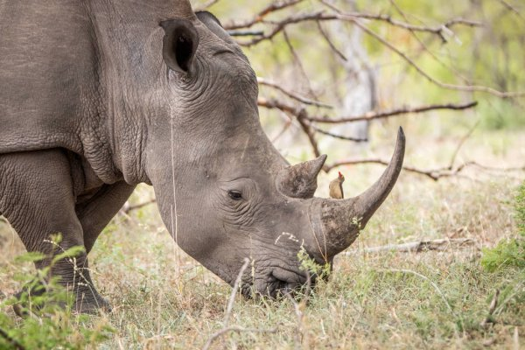
MUTUALISM
In Mutualism both organisms are benefitted. For example the picabueyes and the rhino. The picabueyes eat the parasites off the rhino so, the picabueyes get food and the rhino gets no parasites. The parasite on the rhino are a part of the food the picabueyes eat and helps them from starvation. The rhinos parasites are not good for it and when the picabueyes eats it off the rhino can become healthy again. When these organisms work together it helps them both. Also because the organisms are mutual with each other it helps them get along better and deepen their relationship. The rhino can peacefully eat grass while the picabueyes eats the ticks and parasites. So, they can benefit each other.
Compare and Contrast: Because of the parasites the rhino has the picabueyes do not starve. Since the picabueyes eat the parasites the rhino has the rhino can become heathy. Because of the rhino and picabueyes working together they can both benefit.
Grass → Rhino → Parasites → Picabueyes → Snakes

Slide 3
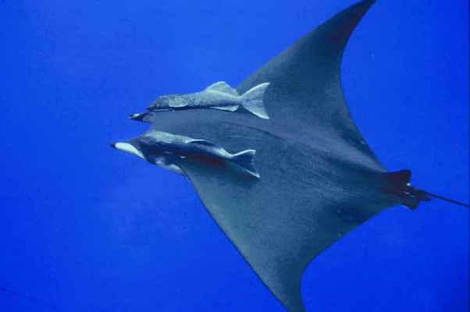
COMMENSALISM
In Commensalism one organism is benefitted and the other is unharmed. For example the Remora fish and the Manta Ray. The disk on a Remora fishes head allows it to attach to things such as Manta Rays. Once the Manta Ray starts to eat the Remora fish eats the extra food. Manta Rays help the Remora fish get food so that they can survive. The Remora fish can also travel with the Manta Ray to get places. The Remora as a similar diet to the manta rays. The fish get this diet because of the attachment to them. Like the animals in mutualism they get along a lot better because of the time they spend with each other. So, the organism can benefit itself without harming the other.
Compare and Contrast: Because of the fish attaching to the manta ray it can go different places. Since the fish eats the food the manta ray eats when it travels the fishes diet consists of thigs the manta ray eat. Because of the Remora fishes head it can attach to things such as Manta Rays.
Remora Fish ← Small Fish → Manta Ray
This Photo by Unknown Author is licensed under CC BY

Slide 4
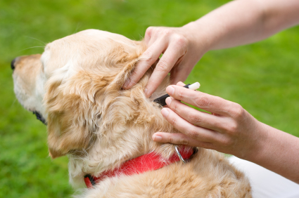
PARASITISM
In Parasitism one organism is benefitted and the other is harmed. For example a dog and ticks. The ticks can benefit because they have dog or otherwise known as the host. The dog though is harmed because ticks can cause disease to dogs. The ticks feed off the dogs blood so it can make the dog weaker too. The ticks can even cause Lyme disease which is bad. But what is even worse is that some parasites can lead to hosts death. Parasitism is not something that’s good. It may be good for one but the other has to be hurt in the process. There are ways to prevent ticks though such as tick collars. So, one organism is benefitted while the other is harmed.
Compare and Contrast: Because of the tick going onto the dog the dog becomes weaker and grows disease. Since the dog got a tick collar there have been no signs of ticks on it. Because of how bad the parasites are they can lead to death
Dog → Parasite → Bird → Fox
This Photo by Unknown Author is licensed under CC BY-SA

Slide 5
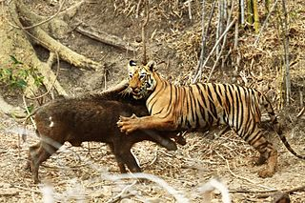
PREDATOR PREY RELATIONSHIP
In Predator Prey relationships an animal eats anther animal for energy and nutrients. For example the tiger and the boar. The tiger in this situation is the predator because it hunts the boar and eats it. The tiger has camouflage so that helps it get prey. The tiger can blend in with the tall grass because of its stripes. The tiger also has sharp teeth and claws to help catch the prey. The boar can try to escape though. The boar has a strong build that could help when a predator like a tiger. The tiger can also be prey depending on what animal it is but it is very un-common. Once the population of boars start to die down so will the tigers and then the boars will grow again. The tigers will grow again and the cycle is repetitive.
Compare and Contrast: Because of the tiger hunting the boar, the boar population decreases. Since the boars die down the tiger population stats to decrease. Because of the tigers camouflage its easier to hunt prey.
Boars → Tiger →Elephant
This Photo by Unknown Author is licensed under CC BY-SA

Slide 6
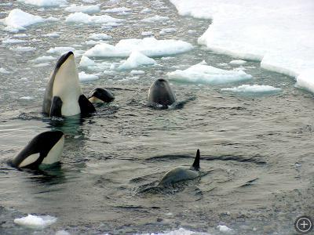
COOPERATIVE
AND COMPETITIVE RELATIONSHIP
In Competitive and Cooperative relationships cooperation is when individuals work together while competition is when two or more individuals or populations try to use the same limited resource. Within a population of killer whales it could be both competitive and cooperative. Some killer whales hunt in groups so they can get more food which is cooperation. But the whales have to compete with other top predators for the food which is competition. Some of the food these animals eat are fish and squid. Even though the whales have a lot of competition with other predators hunting in groups helps them get more food. But since they aren’t the only ones eating the fish and squid they could run out of food. They don’t only eat one type of food though so that helps them thrive too. They share when the competition starts getting higher. So, this shows how they can relate to each other.
Compare and Contrast: Because of the whales hunting in groups they can get food easier and quicker. Since the competition is high it can stop killer whales from getting food. Because of the whales eating more than one thing they can continue to thrive.
Fish → Squid→ Killer Whale
This Photo by Unknown Author is licensed under CC BY-SA-NC

Slide 7
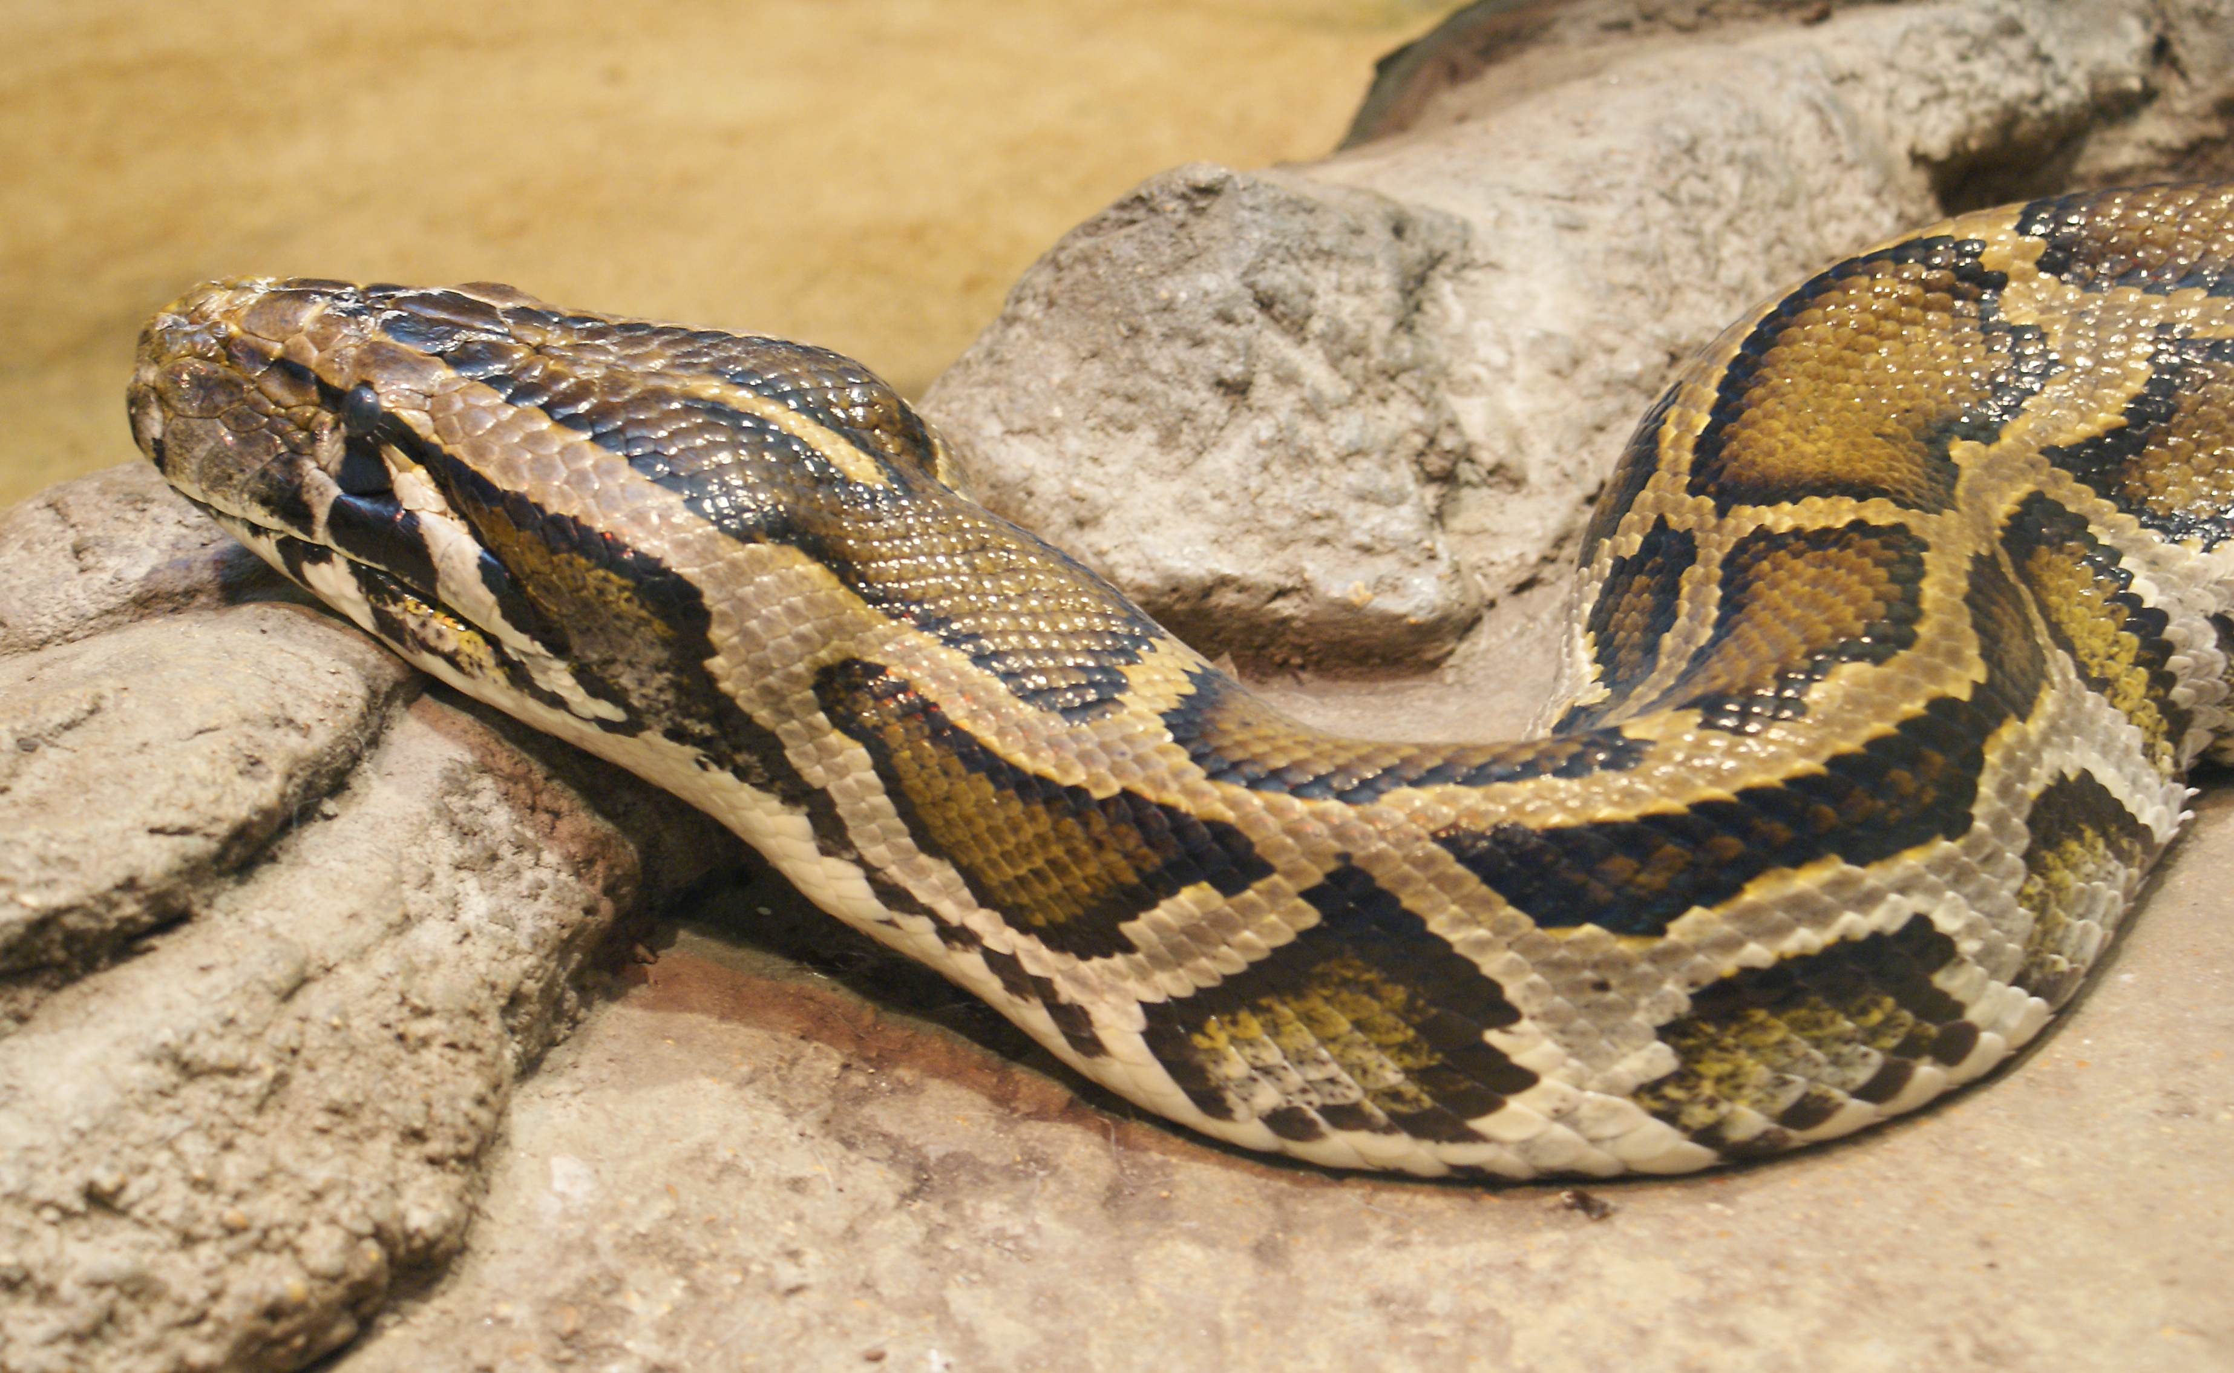
INVASIVE AND NATIVE RELATIONSHIP
In invasive and native relationships the invasive species is something new that negatively alters an environment while native species are something original that’s always been in the environment. Environments can have both invasive and native species. The Burmese Python is a invasive species that came to the South Florida Everglades. They were eating any animal in sight and were extremely dangerous. The native species were being harmed by these pythons which made their population decrease. The native animals could live peacefully before the python came and began to be chaotic. There was so much originality and beauty of the native species but the snake took that away. So, this goes to show there can still be both invasive and native species in one place.
Compare and Contrast: Because of the Burmese Pythons there was chaos in Florida. Since the Pythons ate anything and everything some of the native species in Florida started to die down. Because there were pythons eating all the animals they started to overthrow other species.
Berries → Birds→ Burmese Pythons
This Photo by Unknown Author is licensed under CC BY-SA

